Slide 1
Unified Digital Format Registry (UDFR) Overview and Next Steps to an Operational Registry
Preservation and Archiving Special Interest Group (PASIG)
Austin, January 11-13, 2012
Lisa Dawn Colvin
Abhishek Salve
Stephen Abrams
UC Curation Center
California Digital Library

Slide 2
Agenda
Background
Data modeling
Technology
Demo
Lessons learned
Next steps
Discussion

Slide 3
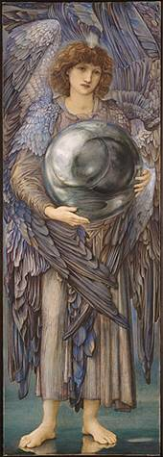
Why formats?
“Format” is the dividing line between bits and information
ffd8ffe000104a46
4946000102010083
00830000ffed0fb0
50686f746f73686f
7020332e30003842
494d03e90a507269
6e7420496e666f00
0000007800000000
0048004800000000
02f40240ffeeffee
0306025203470528
03fc000200000048
00480000000002d8
0228000100000064
0000000100030...
SOI
APP0 JFIF 1.2
APP13 IPTC
APP2 ICC
DQT
SOF0 183x512
DRI
DHT
SOS
ECS0
RST0
ECS1
RST1
ECS2
...
Notes:
Edward Burne-Jones (British, 1833-1898)
The Days of Creation: the First Day, 1870-1876
Watercolor and gouache, 102.2×35.5 cm
Fogg Art Museum, Harvard University, 1943.454
Bequest of Grenville L. Winthrop

Slide 4
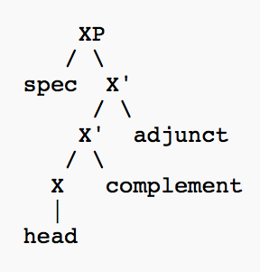
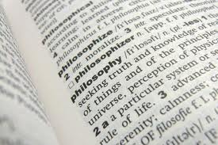
Why formats?
There are many necessary preservation activities that can be usefully performed on bits qua bits
But to preserve information you most act on formatted bits and know what those formats represent
Preservation of content syntax and semantics
(both the structure and meaning of the digital representation)
Notes:
Structure and meaning
Syntax -- http://www.flickr.com/photos/queerdood/4087853415
Philosophy dictionary definition – http://botox4thebrain.com

Slide 5
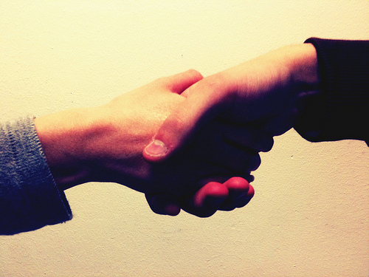
Unified Digital Format Registry
“A reliable, publicly accessible, and sustainable knowledge base of file format representation information for use by the digital preservation community”
“Unification” of the function and holdings of PRONOM and GDFR
http://www.nationalarchives.gov.uk/PRONOM
http://gdfr.info/
Open source platform / GPL
Semantic wiki
Funded by the Library of Congress
Notes:
Shaking hands – Chris-Håvard Berge, http://www.flickr.com/photos/chberge/4670939397

Slide 6



A bit of history…
PRONOM – National Archives [UK], 2002
http://www.nationalarchives.gov.uk/PRONOM
“ready access to reliable technical information about the nature of electronic records”
JHOVE – Harvard, 2003
http://hul.harvard.edu/jhove
“digital object validation and characterization”
GDFR – Harvard/OCLC, 2006
http://gdfr.info/
“a distributed and replicated registry of format information populated and vetted by experts and enthusiasts world-wide”
Notes:
JHOVE – JSTOR Electronic-Archiving Initiative.
GDFR – Andrew W. Mellon Foundation
UDFR – LC/NDIIPP

Slide 7

A bit of history…
Proto-UDFR – Ad hoc stakeholder community, 2009
Resolve PRONOM IPR issues and develop a community-supported open source solution
Advance beyond legacy RDBMS and XML database technology
UDFR – CDL, January 2011
http://udfr.org/
“a semantic registry for digital preservation”
LC/NDIIPP funded
Stakeholder meeting, April 2011
Beta release, November 2011
Production release, January 2012

Slide 8
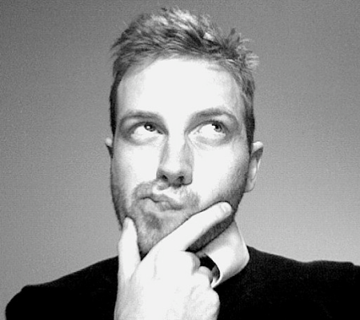
Representation information
What you need to know about something in order to exploit that thing meaningfully [OAIS/ISO 14720]
Information that lets you answer important preservation questions
What format is it?
What are its significant properties?
Is it valid?
Is it at risk?
How can I render/play/read it?
What can it be transformed into?
How?
Notes:
Ponder – Hobvias Sudoneighm, http://www.flickr.com/photos/striatic/2144933705

Slide 9

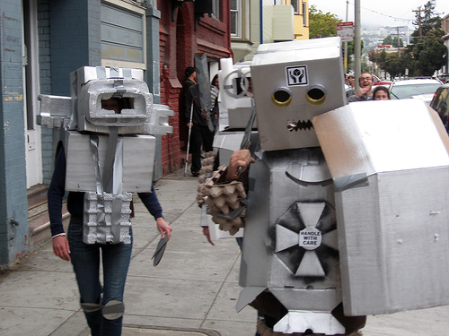
Why semantic?
The semantic web lets anyone say anything about anything
Understandable to both people and machines
The web is (or will be) the semantic web
Linked Data interoperability
Notes:
The age of the democratization of expression
Shout! – Mark Wheadon, http://www.flickr.com/photos/mark_wheadon/2557902153
Robots! – Jere Keys, http://www.flickr.com/photos/tyreseus/527207577

Slide 10
Data modeling
Abstract Base
Controlled Vocabulary
…
holder
dependency
holder
creator
Process
IPR
Agent
owner
Abstract Product
product
Holding
Digest
Abstract Signature
maintainer
reference
file
embodies
ipr
specification
digest
Software
Hardware
Media
Abstract Format
Document
File
External Signature
Internal Signature
input / output
signature
Assessment
Grammar
Character Encoding
File Format
Compression Algorithm
assessment
grammar

Slide 11

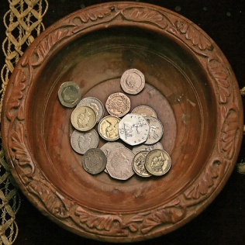


Roles
Consumer Anonymous read
Contributor Consumer privileges + write
Reviewer Contributor privileges + review
Administrator All privileges
Notes:
Shopping cart -- http://www.flickr.com/photos/tjmartins/3889307169
Collection plate -- http://www.flickr.com/photos/lwr/166988094

Slide 12
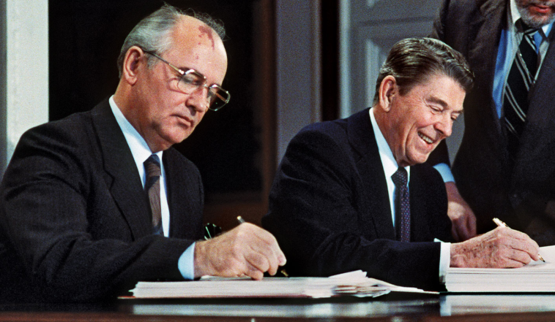
Provenance
“Trust, but verify”
Complete change history
at the assertion level,
including
Who made the assertion, and when?
Confidence based on personal and institutional reputation
Imprimatur by technically knowledgeable reviewers
Notes:
Gorbachev and Reagan -- AFP/Getty Images, http://www.britannica.com/bps/media-view/121436/1/0/0

Slide 13
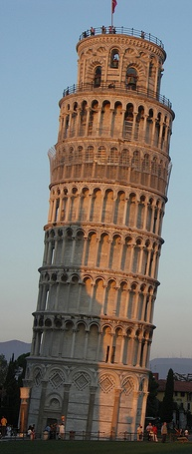
Technology stack
Apache httpd
http://httpd.apache.org/
HTTP / SPARQL
http://www.w3.org/TR/rdf-sparql-query
RDFauthor/JavaScript
https://github.com/AKSW/RDFauthor
OntoWiki
http://ontowiki.net/
Erfurt API
http://aksw.org/Projects/Erfurt
Zend framework
http://www.zend.com/
Virtuoso triplestore
http://virtuoso.openlinksw.com/
PHP
http://www.php.net/
RDF
http://www.w3.org/RDF
Notes:
Leaning Tower of Pisa – Stephen and Claire Farnsworth, http://www.flickr.com/photos/the_farnsworths/2623592483

Slide 14
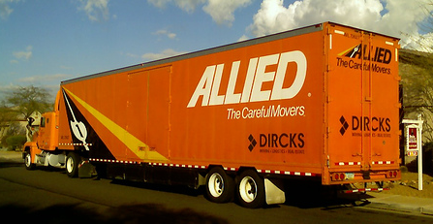
Initial population
Export from PRONOM
http://www.nationalarchives.gov.uk/PRONOM
Working with TNA to identify appropriate subset
Transform to cross-walk modeling differences
Considering other data sources
LC Sustainability of Digital Formats
http://www.digitalpreservation.gov/formats

Slide 15
Licensing
Code is available under GPLv3
http://www.gnu.org/copyleft/gpl.html
Hosted on github
http://www.github.com/UDFR
Data is contributed and available under CC-BY
http://creativecommons.org/licenses/by/3.0/
Consistent with UK Open Government License applicable to PRONOM data
http://www.nationalarchives.gov.uk/doc/open-government-licence

Slide 16
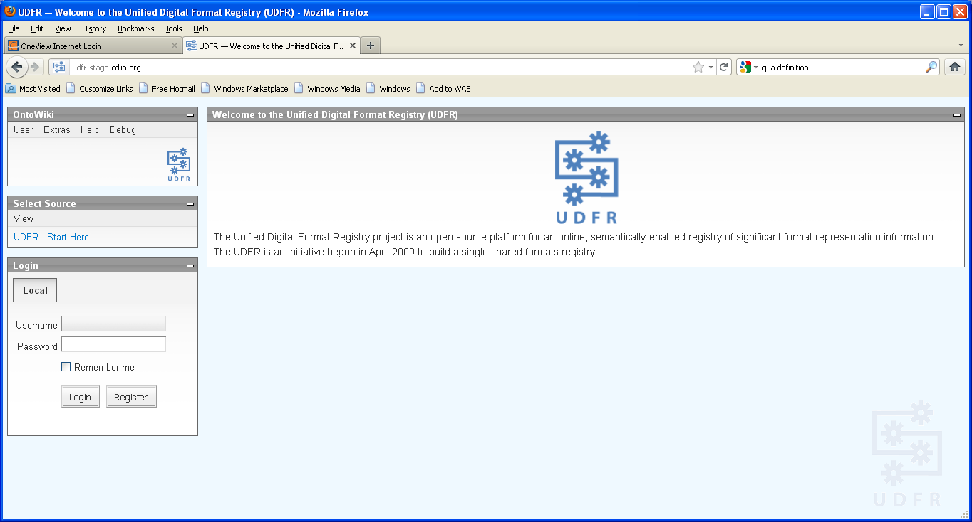
Demo

Slide 17
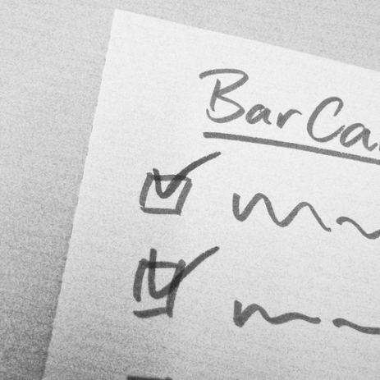
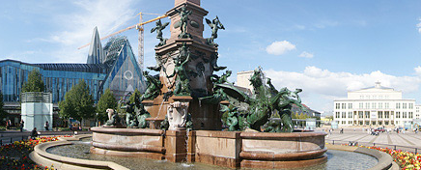
Lessons learned
More difficulty than anticipated integrating disparate open source products
0.x software is often numbered that for a reason
Feature lists aren’t
Make friends with the development community
Excellent support from AKSW/Universität Leipzig
Very responsive to change requests
(always)
Notes:
Checklist -- http://www.flickr.com/photos/adesigna/4090782772

Slide 18
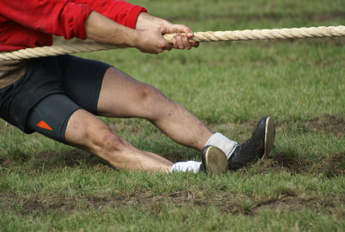
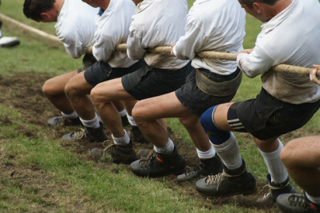

Lessons learned
Try to avoid a moving target
PRONOM and UDFR were simultaneously working on semantic modeling
Even with frequent consultation, we made some different choices
Notes:
Tug of war -- http://www.flickr.com/photos/toffehoff/244870161 / http://www.flickr.com/photos/toffehoff/244870160
Square peg in a round hole -- http://www.flickr.com/photos/21664580@N04/2095574414

Slide 19
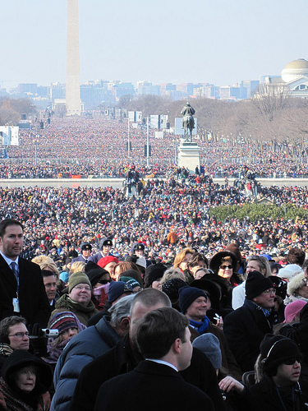
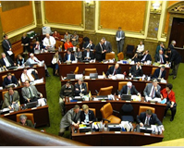
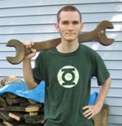
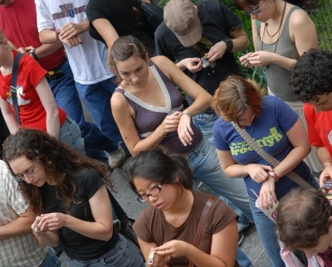
Next steps
Long-term governance and operational support
Technical maintenance and enhancement
Replication/synchronization
Building contributor and reviewer communities
Notes:
Legislature – Mike Refund, http://www.flickr.com/photos/deltamike/3358213826
Wrench – Ed Platt, http://www.flickr.com/photos/philentropist/176054470
Synchronize watches -- http://improveverywhere.com/2006/08/19/slo-mo-home-depot/
Obama inauguration crowd – Brett Farmiloe, http://www.flickr.com/photos/pursuethepassion/3220803117

Slide 20
For more information
UDFR
http://udfr.org/
http://bitbucket.org/udfr
http://github.com/UDFR
PRONOM
http://www.nationalarchives.gov.uk/PRONOM
GDFR
http://gdfr.info/
OntoWiki
http://ontowiki.net/Projects/OntoWiki
Erfurt
http://aksw.org/Projects/Erfurt
RDFauthor
http://aksw.org/Projects/RDFauthor
Virtuoso
http://www.openlinksw.com/dataspace/dav/wiki/Main/VOSRDFWP
AKSW , Universität Leipzig
(Agile Knowledge and Semantic Web)
http://aksw.org/
Philipp Frischmuth Sebastian Tramp
Norman Heino
UC3
http://www.cdlib.org/uc3
uc3@ucop.edu
Stephen Abrams Mark Reyes
Lisa Colvin Abhishek Salve
Patricia Cruse Tracy Seneca
Scott Fisher Joan Starr
Erik Hetzner Carly Strasser
Greg Janée Marisa Strong
John Kunze Adrian Turner
Margaret Low Perry Willett
David Loy

